Slide 1
Application of Redis in IOT Edge Devices
By Glenn Edgar
LaCima Ranch

Slide 2
Overview of Presentation
Description of Irrigation System
How Redis Came to Be Used
Nano Data Center
Role of Graph Data Base
New IOT – Cloud Communication
Lacking One Thing

Slide 3
Brief Description of Our System

Slide 4
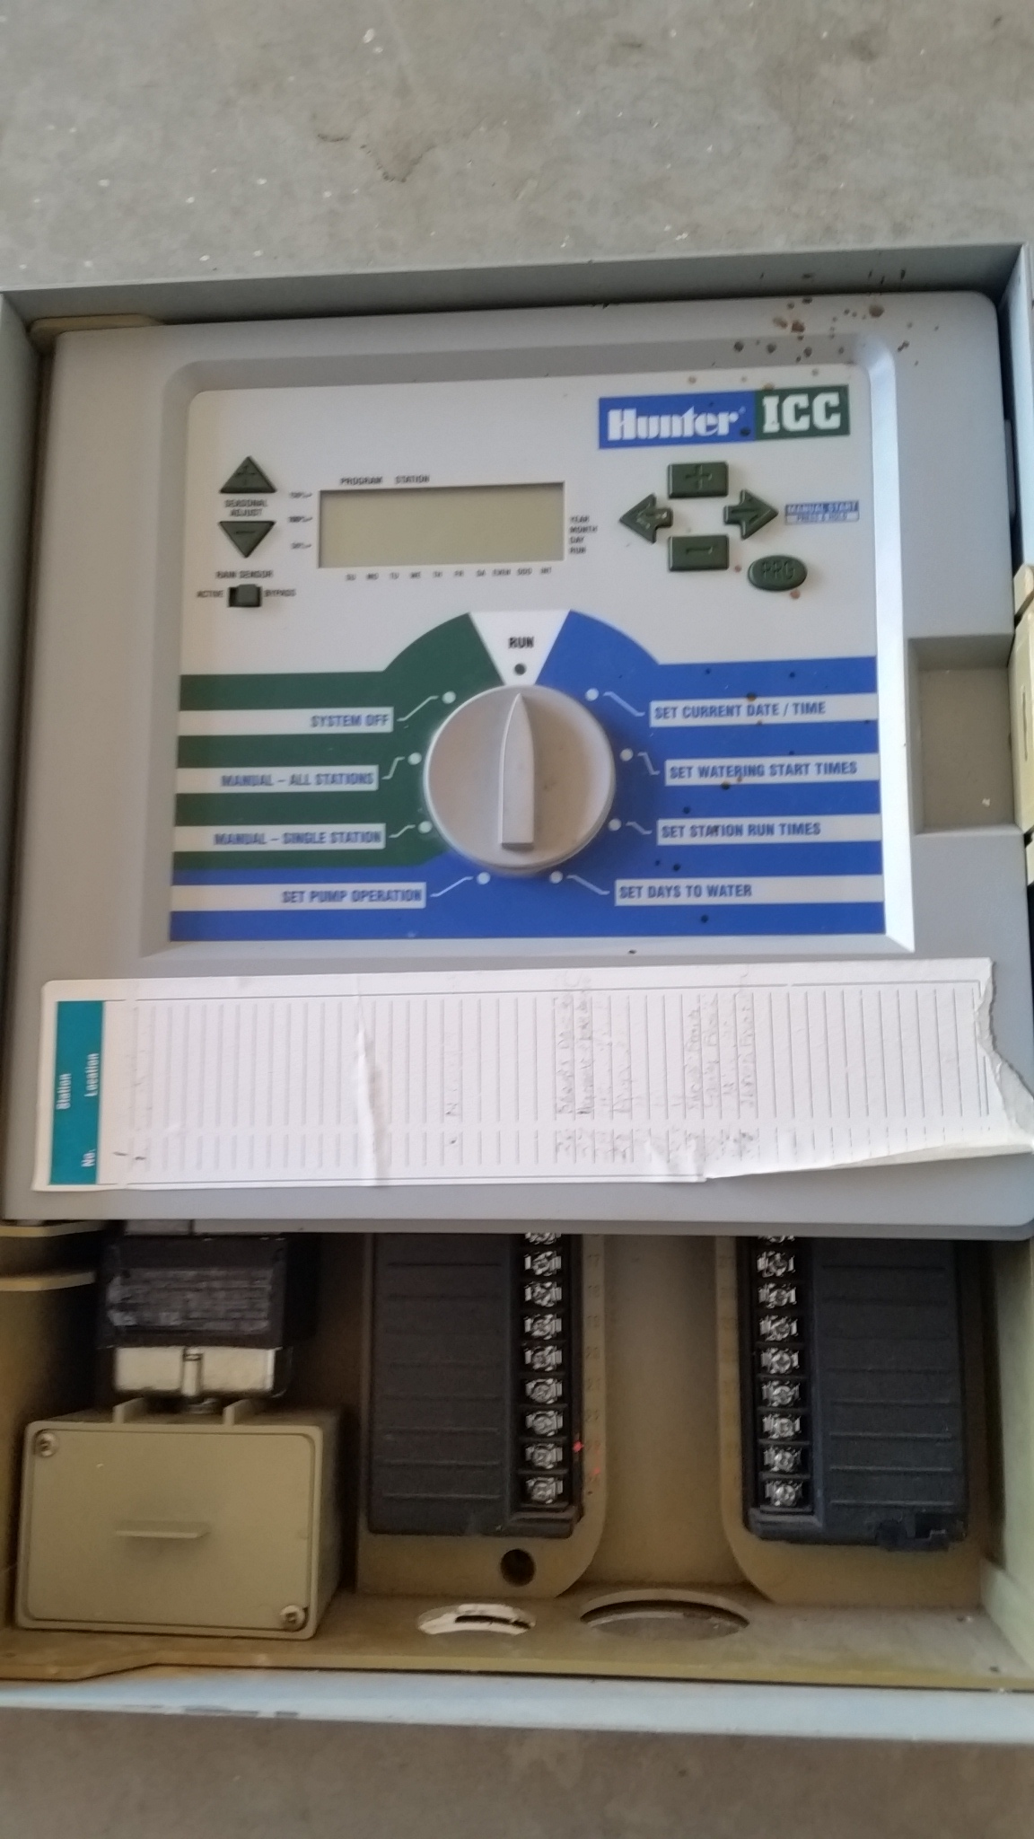
Our Original System
A Hunter 48 station irrigation controller.
The system was set up by clicking dials in a most painful manner.
The system supported only two schedules and was very difficult to change and configure.
At the time this unit would cost around $800 dollars.

Slide 5
Our New System Architecture
Individual
Site Are Design
To Support
Stand Alone Operation
As well as Cloud Integration
Cloud Controller
Individual
Sites
Individual
Sites
Individual
Sites
Individual
Sites
Individual
Sites

Slide 6
Break Out For Site Or Edge Device
1 or more
Raspberry PI
Controllers
See Note
Sprinkler Wire
Distributes Power
And RS485 Communication
Satellite 1
PLC Controller
Satellite 2
PLC Controller
Satellite 3
PLC Controller
Satellite 4
PLC Controller
Note: Till the 2015 time frame the controller was a Beagle Bone Black

Slide 7
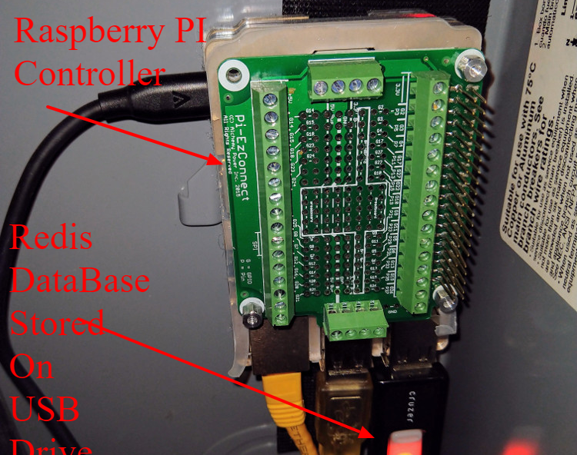
Redis Database is Stored on External USB Drive
The reasons for the use of an external USB drive to store the Redis database is as follows.
Power Failures will happen. Putting Redis on a external USB drive insures that the Linux File System on the SD Card has few writes during operation. This lowers the risk of file corruption during power failures.
By having the Redis Database on an extern USB Drive makes replicating both the SD card and Redis Database easier.

Slide 8
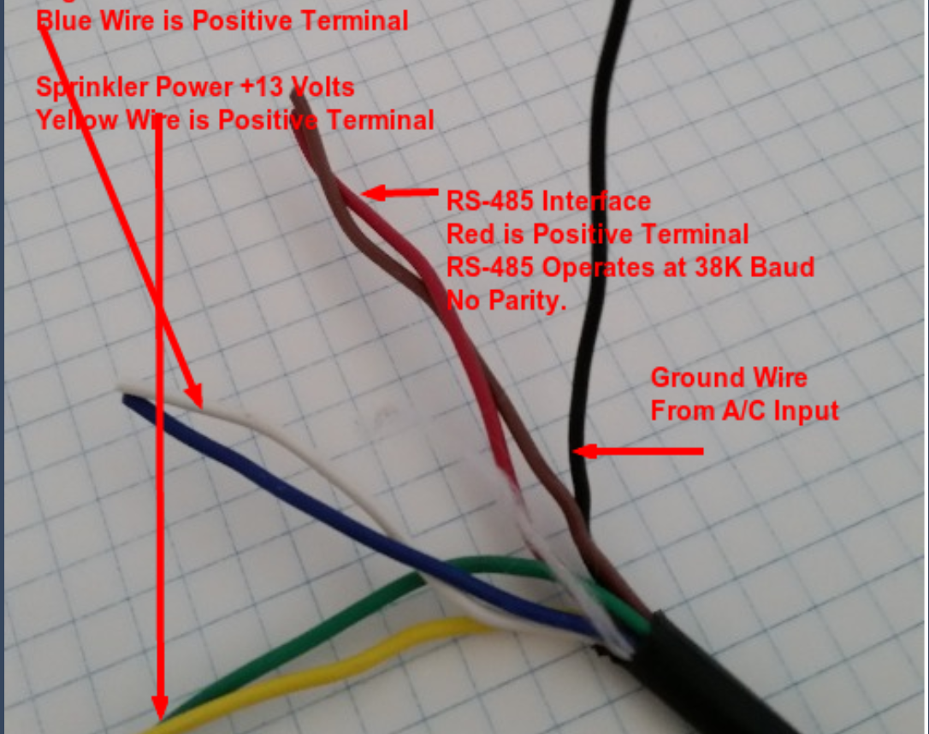
Existing Sprinkler Wire was used as Networking Cable
7 Strand 18 gauge sprinkler wire.
Blue/White 24 Volt DC to power PLC’s.
Yellow/Green 15 Volt DC to power sprinkler solenoid valves.
Red/Orange/Black used to support a 38.8 Kbits RS485 communication link.

Slide 9
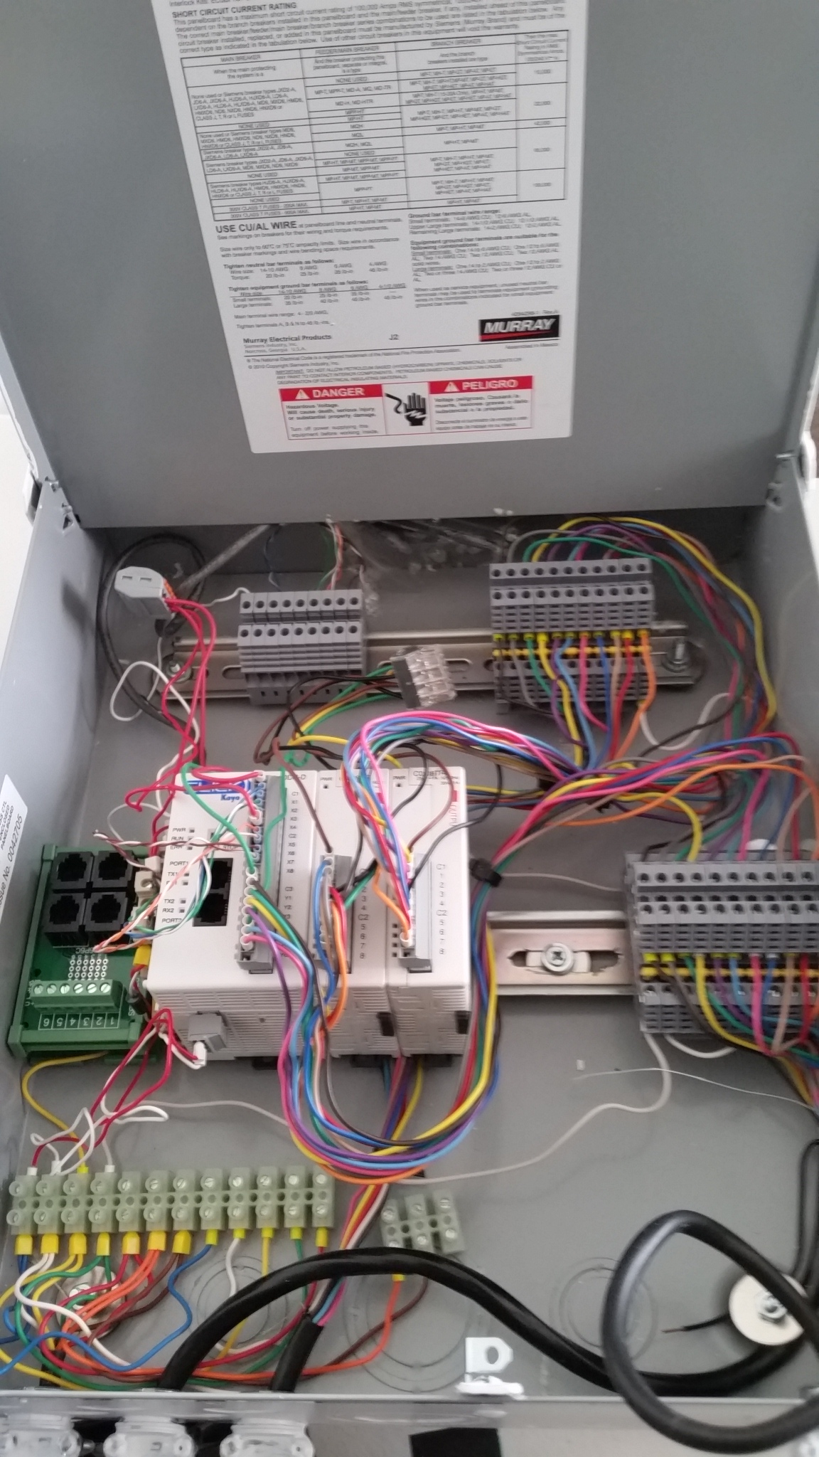
Inside of PLC Case
PLC and Expansion Unit – Automation Direct Click Line. ( Free Programming Software )
SCADA terminal blocks are used to connect wires.
There are 22 sprinkler connections.
8 Digital Inputs which four can be used flow meter interfaces.
System Cost is less than $300.
Components are UL and FCC certified.

Slide 10
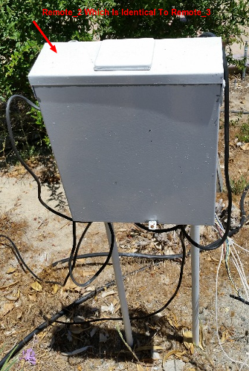
PLC Deployed in the field.
The picture shows the PLC unit deployed to the field.
Electrical conduit pipe is pounded in the ground and the PLC unit attaches to the conduit.

Slide 11
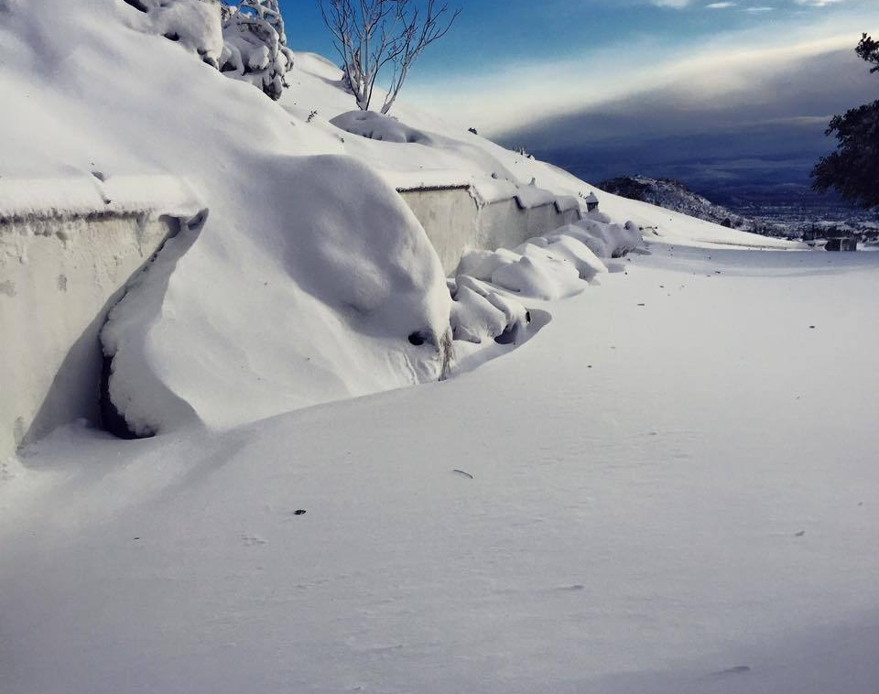
Some PLC Units have been deployed for 5 years.
Our Avocado Grove is a 2400 feet.
Several years ago, we had 24 inches of snow over night.
Outdoor equipment survived without problem.

Slide 12
Some benefits to new system
Web Based Flexible Irrigation Scheduling.
Cloud Interface Allows Remote Operations.
Weather Station integration which allows irrigation times set to water evaporative loss.
Current Sensor to monitor irrigation solenoid performance.
No Current open wires.
Too much current a shorted condition.
Flow Meter to detect leaks and clogged emitters.
Some examples are showed on the next page.
Well Pressure and Pump Current logging will be added shortly.

Slide 13
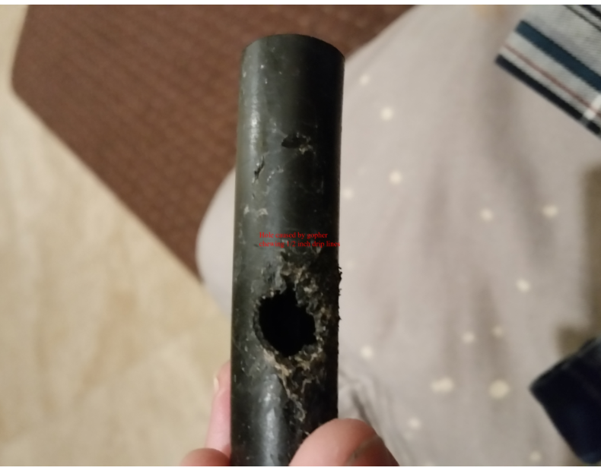
A leak that took 3 weeks to find
The system detected a 3 GPM excess flow. Field Inspections did not find the leak for three weeks.
On the third week, after an exhaustive search, the leak was found. The hole was pointed downward and flowed into a hole. The leak watermarks were not shown in the field.

Slide 14
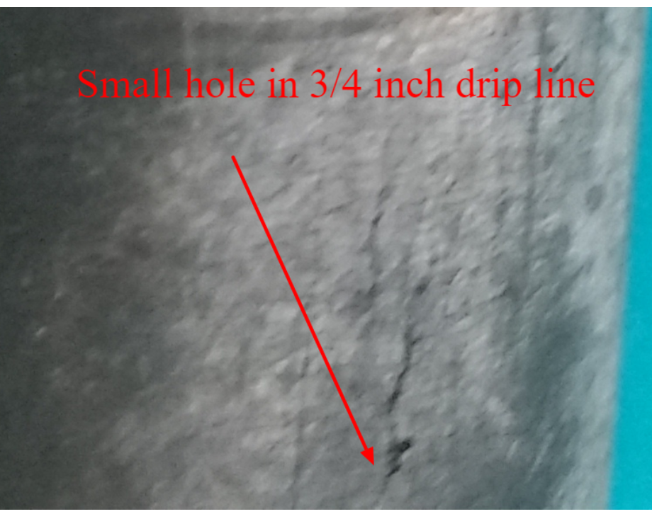
Another Leak not Detectable by manual means.
This line has a small crack which generated a .5 gallon/minute excessive flow. The System detected the excess flow.
The lines had to be checked carefully to find this leak.

Slide 15
New System Transformed Operation
Instead of looking for problems, the system directed action to systems which have failed.
This is important as it takes about 2.5 hours to manually check the grove. At $22.50/hour and once a week, the total cost for manual checking is $2925.00 /year. This is about 3 times the cost of my system.

Slide 16
How Redis Came To Be

Slide 17
Needed to Replace Mongoose Web Server with Python Flask Web Server. (Time Period 2014)
My background is embedded system design.
First starting out in assembly and DSP programming
Moving to C and RTOS Programming.
Moving Embedded Linux and Set Top Box Programming.
And finally introducing Lua, SQLITE, the Mongoose Web Server and jQuery into the mix.
I used the Lua/SQLITE/Mongoose Web Server as my first basis for irrigation control.
The implementation was a single Linux process on a Beagle Bone Black.

Slide 18
Needed to Replace Mongoose Web Server with Python Flask Web Server. (Time Period 2014)
The Mongoose Web Server Needed To Be Replaced
Original
System
Monolithic
Linux Process
Both Processes Need to Communicate
With Each Other
Irrigation Control
Process
Flask Web Server

Slide 19
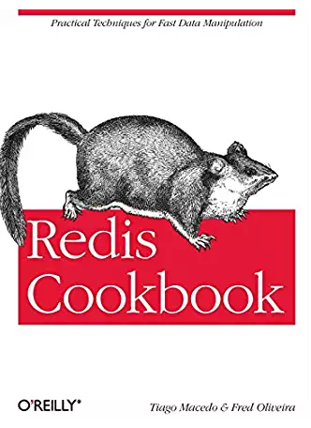
Redis Provided The Persistent Job Queue Communication
Now instead of single process, there are two processes. The architecture had to change.
I picked up a copy of the Redis cookbook and found an example of a job queue.
Redis and Flask Web Server were incorporated on my irrigation system using a Beagle Bone Black.

Slide 20
With Redis in the System The Irrigation Controller Software Began to Change.
With Redis as a central hub, the monolithic irrigation program transformed into:
Lua code was replaced with python code as the need for embedding code went away.
Modular python processes implementing a single function.
Communication through the Redis Data Base.
A python process communicates strictly with the Redis data base with the exception of the I/O controller.
Irrigation
Controller
Time of Day
Scheduling
Program
Flask
Web
Server
Calculate
Evaporative
Loss
Redis Database
Various
System
Monitoring
Processes
I/O Controller

Slide 21
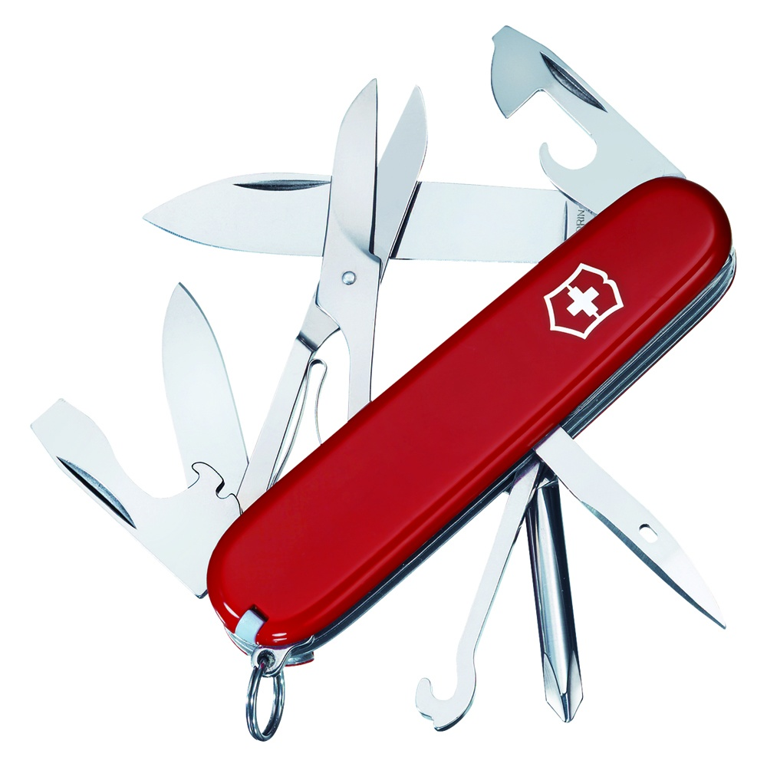
Nano Data Center
Redis as the “Swiss Army Knife” of Nano Data Center

Slide 22

The amount of Logging and Managing the Logging Became Complex.
I read the book, “ART of Monitoring” by James Turnbull and came to the following conclusions.
Redis could do most of the non web functions listed in the book, quite well considering the size of the target.
The IOT gateways should be managed much in the same way one would manage the infrastructure of an online business.
I labeled this environment a “Nano data center”. “micro data center” term was taken as the term referred to an edge device with large disk drives.
Do not manage the system as an embedded device but manage the device as a data center.

Slide 23
Overview of Redis Database
Redis Database
The Redis Database consists of three different types of entities:
Control Structures
Logs or Streams
Configuration Data
Configuration Data consists of user defined irrigation schedules, system definition of items such as
System Items such as master valves
User Defined Irrigation Schedules
User Defined Limits
Configuration data is loaded to Redis from files and stored back to files when changed
If the Redis Data Base is lost then the system will continue to operate. Within a week most of the log streams will have enough information to be fully functional.
Configuration
Files
Configuration
Data
Redis Control
Structures
Job Queues
RPC Servers
Redis Logs
Or Streams

Slide 24
The Redis Database extracts little resources Not Much More Than One of the Application Processes
Process | VSZ | RSS | Redis DB SIZE
Evaporative Loss Cal | 17524 | 13513
Irrigation Control | 44460 | 27764
Flask Web Server | 74380 | 26244
Redis Server | 69892 | 42728 | 41.73 Mbytes

Slide 25
Graph Data Base
The Redis Graph DB Module allows introduction of graph systems to the IOT Edge Device

Slide 26
Adding functions to the system became increasingly difficult. The problem arises from the need to coordinate information between processes both in the gateway device and the cloud.
Storing Configuration Data in XML Table or JSON Document
Store Configuration Data in a Graph Format
Json or XML Document
The Structure of the Document is need to be know to extract information from Document
Information can be extracted
with the graph query language
and a few search terms.
The structure of the graph is not needed
To be totally understood by the user process

Slide 27
As a Sanity Check, Graphical Data Bases Are Appearing In Conventional SCADA Systems.
Redis Cluster is used in a Chinese Electric Utility Company as described in the following paper.
http://dpi-proceedings.com/index.php/dtcse/article/view/5316/4939
In this paper the Key Design for the Redis Database is governed by IEC61970 standard.
A description of the of the IEC61970 can be seen at the following link.
http://citeseerx.ist.psu.edu/viewdoc/download?doi=10.1.1.112.4648&rep=rep1&type=pdf
RDF is used to describe system model and XML is used to describe node properties.
The IEC61970 model is a natural model for a graphical Database.

Slide 28
Nature of Graph – SNMP on Steroids
Cloud Graph
Edge Device Graph
Makes it easier to push changes from cloud to IOT device and from IOT device to cloud
Edge Device Graph is a Subgraph of the Cloud Graph

Slide 29
System Graph is Constructed at Startup
System
Code scripts construct the system graph upon startup.
The construction is done in a modular manner.
The code is under configuration control and changes to the system graph can be tracked.
As a side note, with Grafana Dashboards, some organizations are using python scripts to setup dash board, which supports this type of graph construction.
Site
Controllers
Controller A
Controller B
IOT_Control
Applications
Attached Processes
To Controller A

Slide 30
The Graph Structure for around the weather stations
Site Node
Note Relationships
And properties Not Shown
Applications Node
The weather station application will first query for the Weather Station Node, such that the path goes through the site node with the site property in the “site.json” file.
Once the weather station node is found, then the two stream data structures are found and constructed.
Next the weather station nodes are found and packages constructed for each weather station.
Computing the ETO and Rainfall is a matter of executing all the weather station sites and combining the values in a manner specified in node properties.
Weather Station Node
Data Package Node
WS_Station Relationship
Stream for Daily
Rain Values
Stream for
Daily ETO
Values
Individual Weather Stations

Slide 31
Redis Keys and Access Classes Can Be Automatically Generated. The Automatically Generated Keys are Unique Across The System. The Unique Keys make cloud integration much easier.
There Are Two Sources of Data Structures
Data Structures
defined by the system graph
Such as job queues and logs ( streams )
Data Structures
defined by user generated
configurations like irrigation
schedules.

Slide 32
With The System Graph and the Ability to Autogenerate Redis Access Handlers, adding new applications is much easier.
First Step Add Nodes and Relationships to the Graph.
Determine Graph DB Cypher commands to query the Graph.
The application will query the graph and then
Obtain operational parameters
Automatically Generate Data Structure Handlers

Slide 33
New Form of IOT – Cloud Communication

Slide 34
The Redis Graph Changes The Nature of IOT to Cloud Communication
Consider the following, ETO, ( evaporative loss), calculation process.
The ETO process receives data from the graph about weather station data such as URL's and access tokens.
The ETO process will calculate the daily ETO and update the moisture deficient table and the ETO History Stream.
The Irrigation Controller will use the moisture deficient table to determine irrigation run lengths.
The Web server access both data structures to display to the user and to manually adjust the moisture deficient table if necessary.
Graph Data
Irrigation Controller
Moisture
Deficient
Hash
Table
Process to calculate ETO
ETO History Stream
Web Server

Slide 35
Move ETO Data To The Cloud
A case can be made that the ETO calculation should be done at the cloud as each weather station could have different URL's and access tokens. The processing would look like this.
Cloud Graph Data
Moisture
Deficient
Hash
Table
Synchronization
Mechanism to keep cloud and edge device data bases loosely synchronized
Irrigation Controller
Moisture
Deficient
Hash
Table
Process to calculate ETO
ETO History Stream
ETO History Stream
Web Server

Slide 36
Introduction of Machine Learning and Deep Learning is Simpler with this Architecture
IOT Database
Cloud Data Base
Deep Learning
Processes
Synchronization
Mechanism to keep cloud and edge device data bases loosely synchronized
Machine Learning
Processes
IOT Data Streams
Cloud Processes Have Access to IOT Streams without having to add
additional code and additional MQTT or AMQP Messages

Slide 37
Method Of Synchronization
Application
Redis Data Structure Handler
AMQP Channel From Cloud to IOT Device
AMQP Server
Take Update
Commands
And Apply
To Redis Database
Redis
Cloud
Database
Redis
IOT
Database
AMQP Channel From IOT Device to Cloud
AMQP Server
Take Update
Commands
And Apply
To Redis Database
Redis Data Structure Handler
Application

Slide 38
A Limited Number of Commands, (less than 30?) to Synchronize the IOT and Cloud Databases.
Examples of Synchronizing Commands
Update Stream
Update Hash Element
Push Job Queue
Pop Job Queue
Application
Redis
IOT
Database
AMQP Server
Take Update
Commands
And Apply
To Redis Database
Redis Data Structure Handler
Redis
Cloud
Database
AMQP Channel From Cloud to IOT Device
This compares to a conventional MQTT or a conventional AMQP connection, where there are messages for each instance of data. There could be hundreds of unique messages.

Slide 39
Lacking One Thing

Slide 40
Lacking One Thing -- Need Open Source Projects in This Area
Why is this important?
The Agricultural Control Systems and SCADA systems in general are dominated by Vertical and Closed System.
This is in contrast to most online systems for example:
Redis interfaces with MySQL
Redis and MySQL interfaces with Web Server
Open Source Projects will build up a community to break the hold on the Closed Systems that dominate the current environment.
Lacima Ranch will offer our experiences in helping to build this new community.

Slide 41
Thank You

